Slide 1
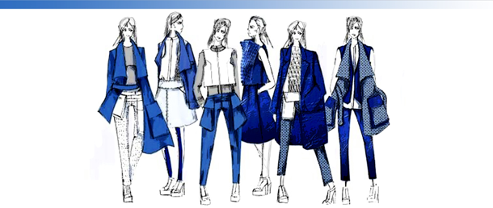
www.eurotexwear.com | firoj@eurotexwear.com
Eurotex Wear
Ultimate clothing to see the world

Slide 2
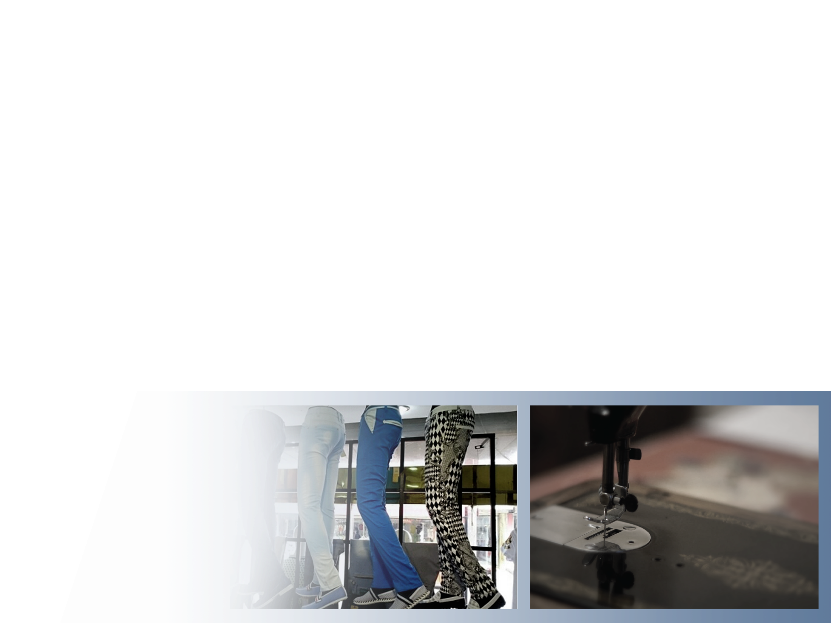
Who we are...
EUROTEX WEAR has come a long way and initially started business as a fabric provider and grown consistently as a valuable service provider of the expanded garments industry.
FIROJ HOSSAIN is the founder of EUROTEX WEAR who establish this company 5 years back in the year 2018 and started an apparel sourcing business in the Garments sector the in the same year.
We build up a strong sourcing strength and build up a young energetic team full of expertise in their own field and offered customers the to be “Ultimate clothing to see the world” by creating true benefits in your supply chain.

Slide 3

EUROTEX WEAR leaders…
FIROJ HOSSAIN (FOUNDER & MD)
TANVIR AHMED
Farzana Akter
Shafiqul Islam
Mizanur Rahman

Slide 4
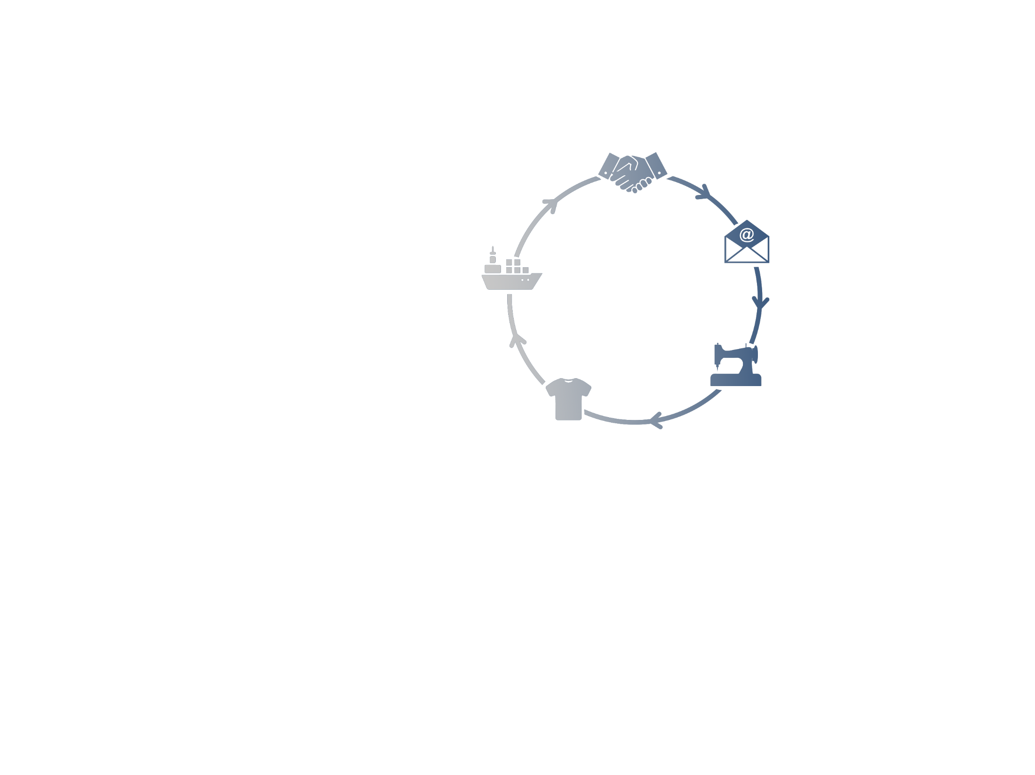
Our Service…
Working as buying agents/local representative to execute the orders on behalf of the customer/buyers.
Sourcing Cost effective and Quality Apparel items with specialized from leading class and compliant Factories.
Bulk Production follow up, inline inspections, final inspections by our qualified & experienced Quality Auditors/quality Assurance Inspectors.
Monitoring and assuring on time delivery/shipment of garments for the customers.
Monitoring compliance issues very closely.

Slide 5
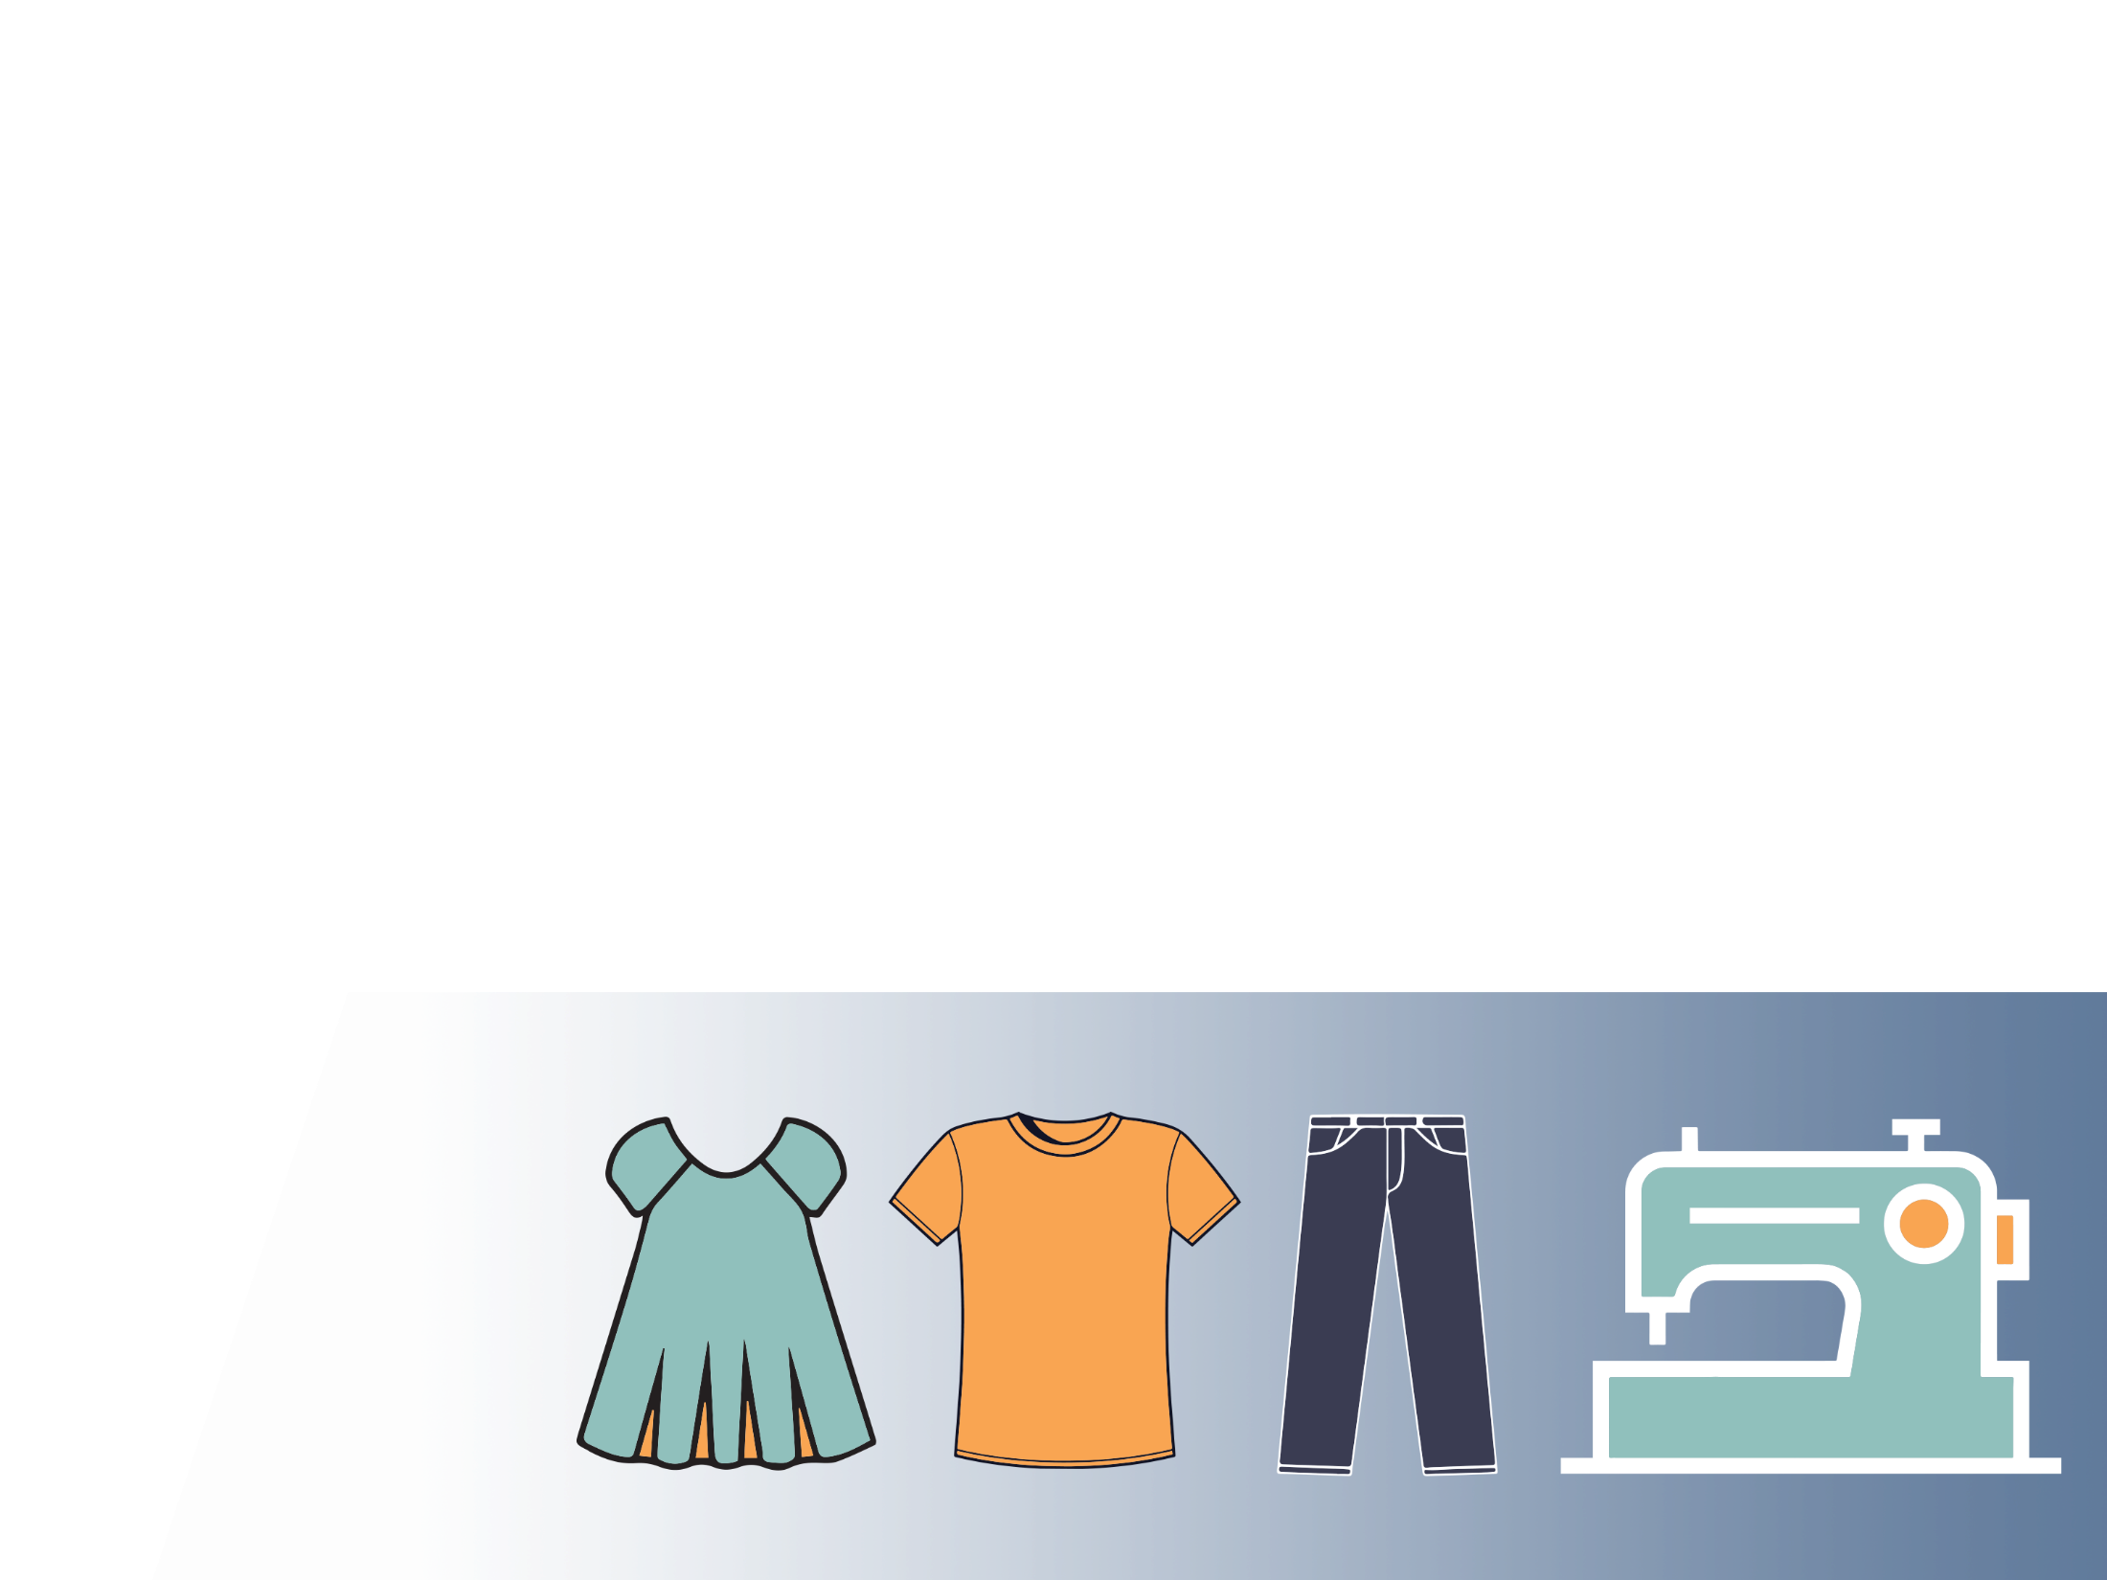
Our Team…
Design & Development ----- Sourcing & Merchandising ----- Production & Quality ----- Logistic --- HR. Admin & Compliance.
Design & Development:
We have established our own design & development team to implement our innovative idea and represent a good number of design range for the customers.
2 fashion designer ---- 1 graphics designer- 1 Product developer
Additionally we have a sample section including one skilled technician with 10 sample man & one quality responsible under our Design & Development team.

Slide 6

Sourcing & Merchandising Team:
We have strong Sourcing & Merchandising team leading by Firoj Hossain (FOUNDER & MD). Under his supervision team is below:
Firoj Hossain (FOUNDER & MD)
Tanvir Ahmed

Slide 7

Production & Quality…
To secure the garments delivery & maintain the quality we have strong production and quality team of more than 12 members who analysis and choose right factory based on product category & factory certification to fulfil customer requirement.
Commercial Team…
We have well experienced team for shipping and logistic To ensure best support by communicating with freight forwarders on behalf of customer.
Audit & Compliance Team…
Employee is the key of company success and their we-being is always at the forefront of our thinking.
We have our team of 2 members for factory internal Audit & compliance.

Slide 8

Customers…
Spark Factory Studios (Canada)
Bluenotes (Canada)
Aéropostale (Canada)
Thrifty's Inc. (Canada)
YM Inc. (Canada)
UFO Jeans (Canada)
LEMUR (Canada)

Slide 9

Business Partners…
HBS Apparels Ltd. (Its Woven bottom factory)
KEMS Fashions Ltd. (Its Woven bottom factory)
SMEE Apparels Ltd. (Having vertical set up for Woven items)
Himalaya Sourcing Ltd. (Woven Bottom Factory)
Ruposhi Knit Wear Ltd. (Having vertical setup Knitting, Dyeing, Sewing, Printing, Embroidery, Washing & Trims facility)
Friends Knitwear & Accessories Ltd. (Having vertical setup Knitting, Dyeing, Sewing, Printing, Embroidery, Washing & Trims facility)
Kea Group (Having vertical setup Knitting, Dyeing, Sewing, Printing, Embroidery, Washing & Trims facility)
Bitopi Group (Having vertical set up for Woven items with Washing, Embroidery)
Tas Knit (Having vertical set Knitting, Washing, Sewing, Embroidery & Trims facility)
Alim Knit (Having vertical setup Knitting, Dyeing, Sewing, Printing, Embroidery, Washing & Trims facility)
Axis Knitwear (Having vertical setup Knitting, Sewing, Printing, Embroidery facility)
Passion Denim (Its Woven bottom factory with Washing facility)
Naf Fashion (Its Woven factory with Washing facility).

Slide 10
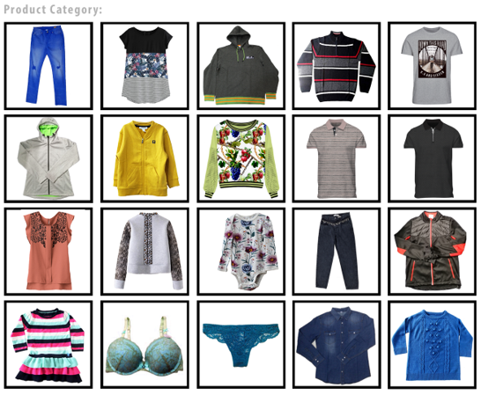

Slide 11
Thank you so much for being with us…………..
Corporate office:
House# 17, Road # 31, Block # D, Pallabi,
Mirpur-12, Dhaka 1216, Bangladesh.

